Slide 1

Note: The data and information in this document is reflective of a hypothetical situation and client. This document is to be used for KPMG Virtual Internship purposes only.
Sprocket Central Pty Ltd
Data analytics approach
Created By : Adarsh Kumar

Slide 2
Note: The data and information in this document is reflective of a hypothetical situation and client. This document is to be used for KPMG Virtual Internship purposes only.
Agenda
Introduction
Data Exploration
Model Development
Interpretation

Slide 3
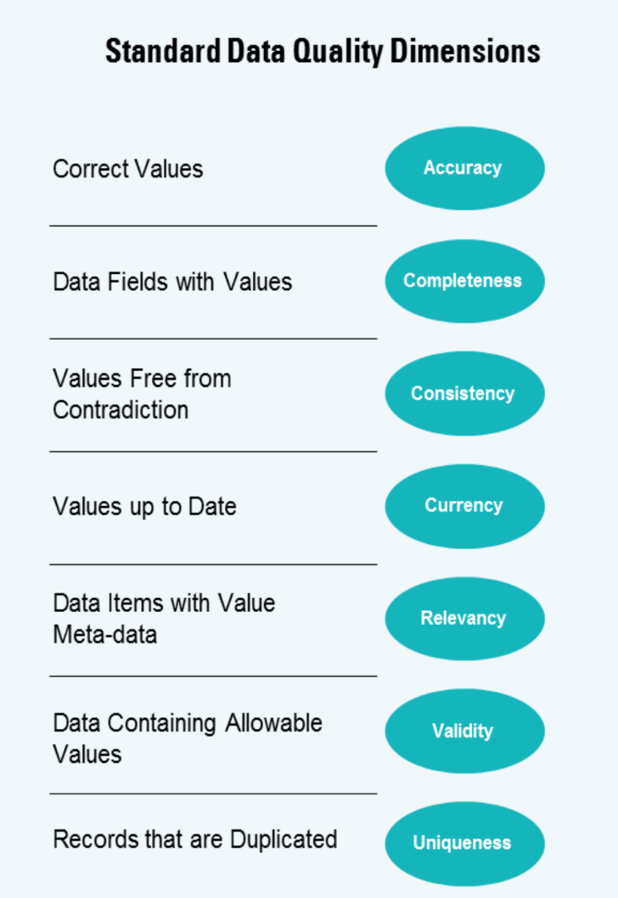
Note: The data and information in this document is reflective of a hypothetical situation and client. This document is to be used for KPMG Virtual Internship purposes only.
Introduction
Customers Analysis
Customer ID
Age distribution
Number of bikes purchases in 3 years / percentages purchases
Wealth Segments
Number of cars own on in Australia

Slide 4

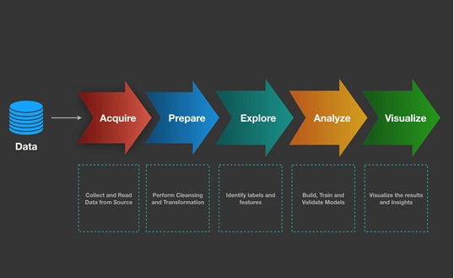
Note: The data and information in this document is reflective of a hypothetical situation and client. This document is to be used for KPMG Virtual Internship purposes only.
Introduction
Sprocket Central Pty Ltd

Slide 5

Note: The data and information in this document is reflective of a hypothetical situation and client. This document is to be used for KPMG Virtual Internship purposes only.
Data Exploration
Data exploration is one of the initial steps in the analysis process that is used to begin exploring and determining what patterns and trends are found in the dataset. An analyst will usually begin data exploration by using data visualization techniques and other tools to describe the characteristics of a dataset. Using the best tools for data exploration enables analysts, IT professionals and business executives to draw substantive insights and quickly identify which data to analyze further.

Slide 6
Note: The data and information in this document is reflective of a hypothetical situation and client. This document is to be used for KPMG Virtual Internship purposes only.
Why Data Exploration is Important?
Exploration allows for deeper understanding of a dataset, making it easier to navigate and use the data later. The better an analyst knows the data they’re working with, the better their analysis will be. Successful exploration begins with an open mind, reveals new paths for discovery, and helps to identify and refine future analytics questions and problems.

Slide 7
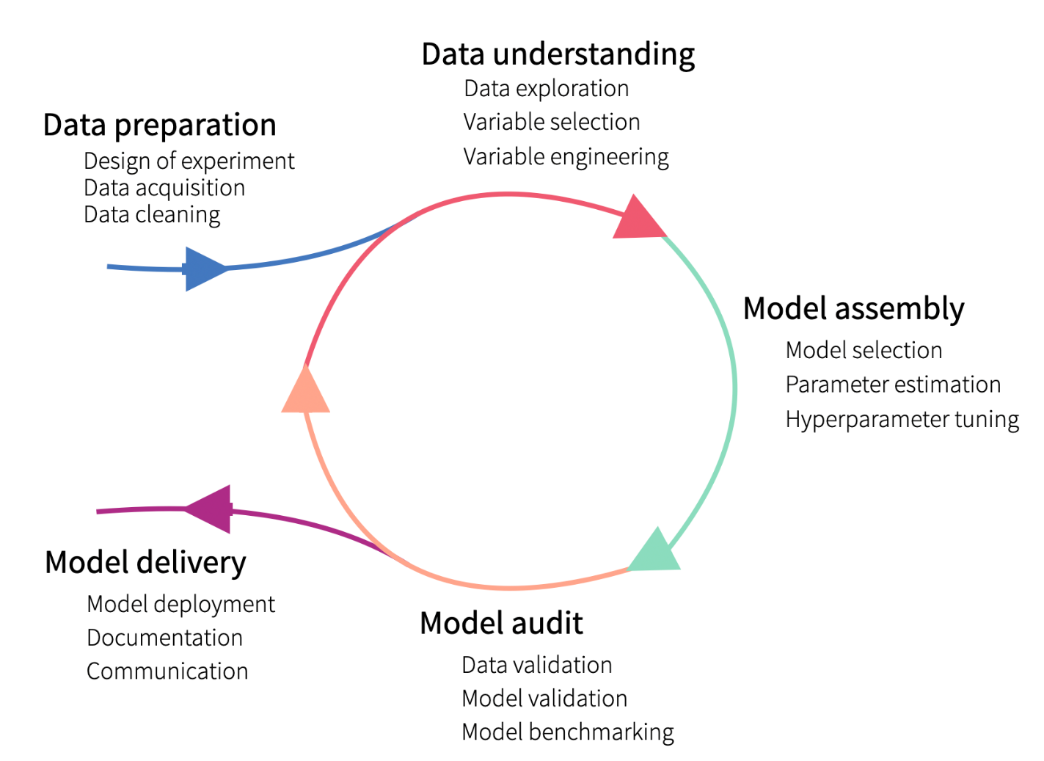
Note: The data and information in this document is reflective of a hypothetical situation and client. This document is to be used for KPMG Virtual Internship purposes only.
Model Development

Slide 8
Note: The data and information in this document is reflective of a hypothetical situation and client. This document is to be used for KPMG Virtual Internship purposes only.
Model Development
The model development process in data analytics involves several stages, from understanding the problem and gathering data to deploying and evaluating the model. Here's a step-by-step overview of the typical model development process:
Problem Definition: Clearly define the problem and objectives.
Data Collection: Gather relevant data for analysis.
Data Preprocessing: Clean, transform, and prepare the data.
Exploratory Data Analysis (EDA): Explore and gain insights from the data.
Feature Selection: Identify the most important variables.
Model Selection: Choose an appropriate model or algorithm.
Model Training: Fit the model to the training data.
Model Evaluation: Assess the model's performance using metrics.
Model Optimization: Fine-tune the model and its parameters.
Model Deployment: Implement and integrate the model into production.
Model Monitoring and Maintenance: Continuously monitor and update the model as needed.

Slide 9
Note: The data and information in this document is reflective of a hypothetical situation and client. This document is to be used for KPMG Virtual Internship purposes only.
Thank You

